Slide 1



Slide 2


sed
grep
scp
dircmp
tar
Expecto Patronum
crontab
fortune | cowsay
Put down the mouse - pick up your wand
Professor Charles Jackson

Slide 3

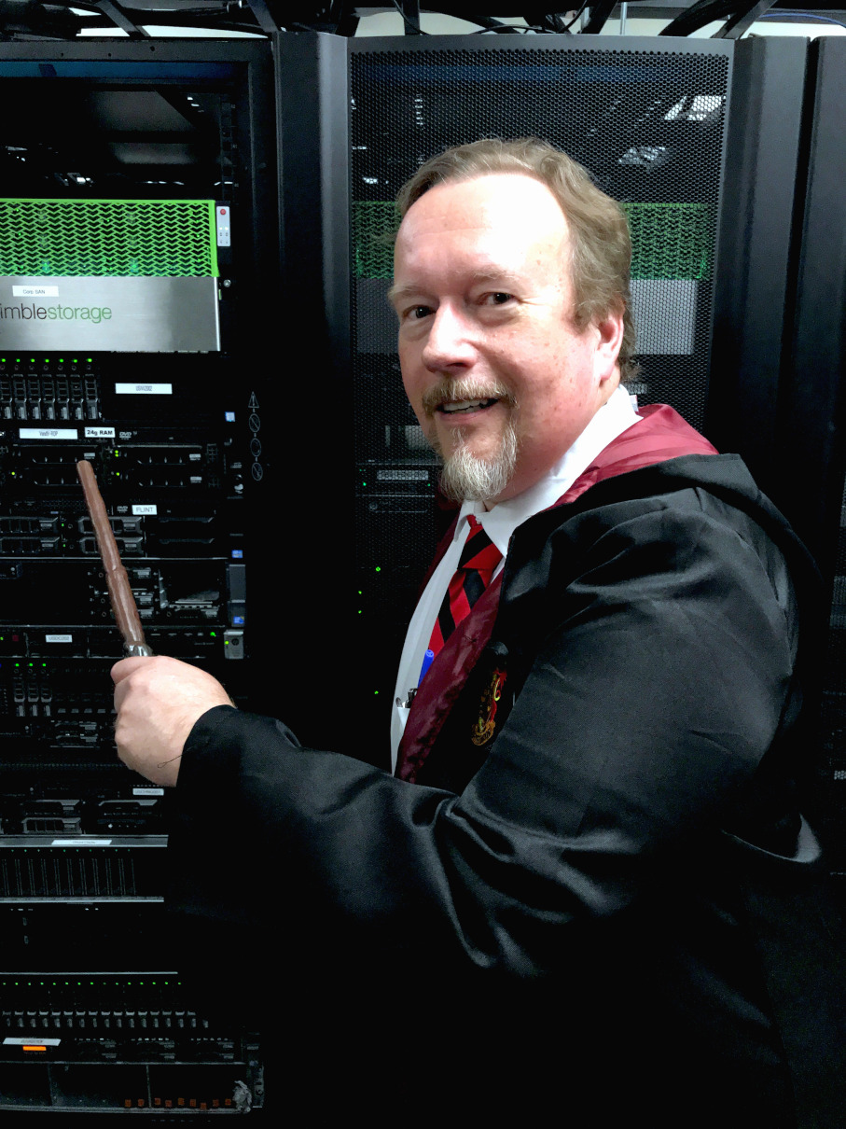


Charles Jackson Senior Web Manager Fujifilm SonoSite
Assistant Headmaster Kernighan House Hogwarts School of Witchcraft, Wizardy, and Linux
Since 1985, I’ve built tools on BSD 4.13,
Unix SVR4, Solaris 2 through 11, AIX, Linux,
Darwin, Irix, Compuserve GIS, and Atari DOS/TOS command-line systems.

Slide 4


Fujifilm SonoSite is the global leader in
point-of-care ultrasound.
We self-host a suite of Drupal-based
product sites, educational sites, and
web-based apps.

Slide 5

Before we begin, you should
know a little bit about:
Logging in to a Linux system with ssh, PuTTY, etc.
Moving between directories (cd)
Editing a simple text file (vim, emacs, or other)
Creating & using file and database backups

Slide 6

But if you don't know any of that, these links will get you started:
http://www.ee.surrey.ac.uk/Teaching/Unix/unix1.html
https://www.liquidweb.com/kb/new-user-tutorial-basic-ssh/
https://ryanstutorials.net/linuxtutorial/vi.php

Slide 7

We have a lot of material to cover! Presentation slides, spells & sample code
may be manifested from:
https://github.com/nightbeacons/Expecto_Patronum

Slide 8
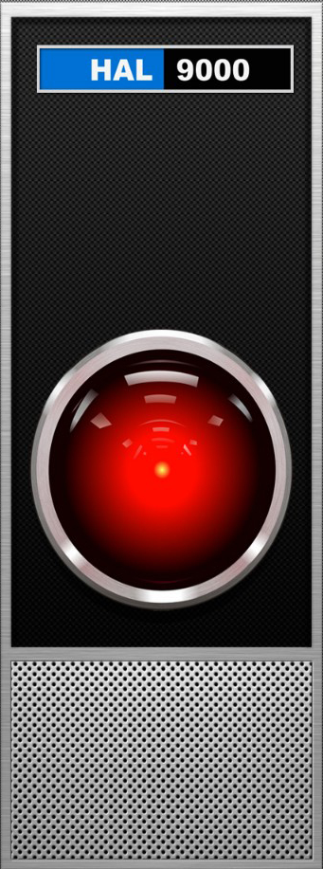
The Command Line –
- - - So Why Bother???
When an interface can't
(or won't)
do everything you need…

Slide 9

The Command Line –
- - - So Why Bother???
…it may be necessary to
go around that interface

Slide 10



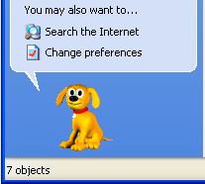



The Command Line –
- - - So Why Bother???
…and sometimes the interface is just too annoying

Slide 11



Strange-sounding, hard-to-pronounce words and phrases
Amazingly powerful (and amazingly dangerous)
Ancient, seldom-changed texts, authored by wizards with long hair and beards who dress funny
No wizard knows all of it
Pretty scary to muggles and mortals
Notes:
Original UNIX manual written in 1970. The basic commands have been unchanged in 50 years.

Slide 12

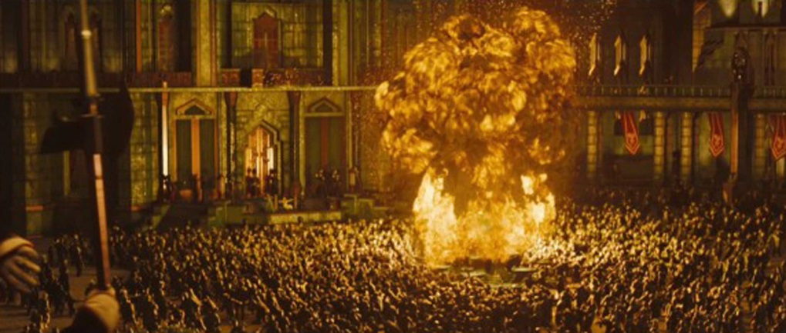
Safety First
Practice in a sandbox, scratch directory, or other non-critical area
Have a recovery plan
Backups are your friend
Anything that can blow-up probably will. Be Prepared.

Slide 13
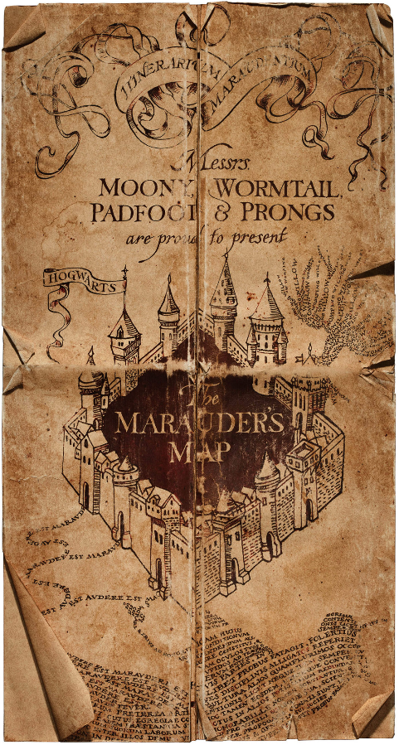
Where Am I???
It's easy to get lost.
How to get un-lost
pwd -- Print Working Directory
cd -- Return to your Home directory
Adding your location to your system prompt

Slide 14
Changing your System Prompt
Most system prompts look like this:
Use a PS ("prompt statement") setting to change it:
export PS1='\@ \[\033[01;31m\]\u@\H:\[\033[01;34m\] \w \$\[\033[00m\] '
Which changes your prompt to this:
[cjacks@hogwarts ~]#
10:57 AM cjacks@hogwarts: /home/cjacks #
Notes:
Don't worry about copying this down -- you can download the slides and other goodies.
The 'export' command is only good for your current login session. The next time you log-in, you'll be back to your old prompt. (We can fix this!)
Also -- be sure to use SINGLE quotes, and note the space at the very end.
By the way, 'ps' is also a Linux command (which has nothing at all to do with system prompts)

Slide 15
Changing your System Prompt
Making it sticky
Add this export setting to your .bashrc file.
Excerpt from sample .bashrc file:
alias cp='cp -i'
alias rm='rm -i'
export PS1='\@ \[\033[01;31m\]\u@\H:\[\033[01;34m\] \w \$\[\033[00m\] '
For more PS fun, see https://www.cyberciti.biz/tips/howto-linux-unix-bash-shell-setup-prompt.html
Notes:
This will only change the prompt for your account -- it will not affect anyone else's.
Be mindful of the single quotes, and the ending space.

Slide 16
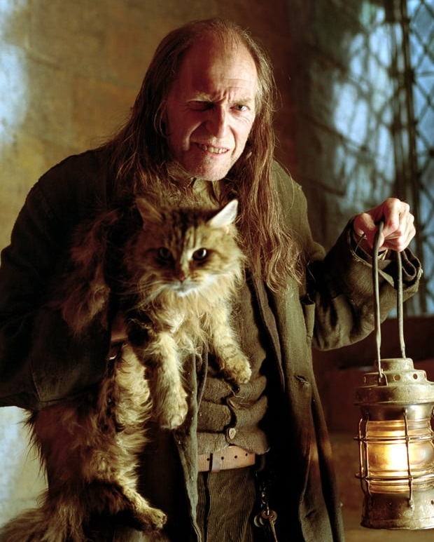
cat
"concatenate"
Display the contents of one or more text files: cat settings.php cat *.html cat one.txt two.txt
Concatenate files: cat *.log > all_in_one.log

Slide 17

Redirection
> Write the output of a command to a file: date > my_date_file.txt
my_date_file.txt now contains the string:
Thu Dec 28 11:13:57 PST 2017

Slide 18
Redirection
>> Same as before, but append to a file: echo "hello world" >> my_date_file.txt
my_date_file.txt now contains the string:
Thu Dec 28 11:13:57 PST 2017
hello world

Slide 19
Redirection
| Pass the output from one command to another: cat log.txt | mail –s "Logs" it@hogwarts.edu
ls -1 /tmp/* | sort -–ignore-case > sorted.txt
ls -1R sites/default/files | wc –l
ls –lt | more

Slide 20

Brilliant and Useful Linux Spells
aliases and functions

Slide 21
Spells for Linux
add them to your .bashrc file
# Safety Nets
alias rm='rm –i'
alias mv='mv –i'
alias cp='cp –i'
alias dc='cd' # Fat fingers
Notes:
After making these changes, these will be available on your next login. To see the changes immediately, type source .bashrc

Slide 22
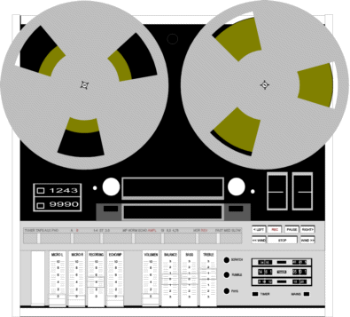
Bash Aliases - history
Spells for Linux - add them to your .bashrc file
# Tools
alias h='history'
Records and plays-back your commands
Notes:
If you run it under sudo or as root, it shows the commands of other sudo users

Slide 23
Bash Aliases - history
Example:
h
8924 [2017-12-28 16:29:49] meminfo
8925 [2017-12-28 16:52:41] dircmp d_one d_two
8926 [2017-12-28 17:04:56] more .bashrc
8927 [2017-12-28 17:05:49] ls /tmp
8928 [2017-12-28 17:34:08] history
!! repeats the previous command
!8927 repeats command 8927 Up/Down Arrows to scroll

Slide 24
Bash Aliases - cpuinfo
Spells for Linux - add them to your .bashrc file
# Tools
alias cpuinfo='lscpu'

Slide 25
Architecture: x86_64
CPU op-mode(s): 32-bit, 64-bit
Byte Order: Little Endian
CPU(s): 10
On-line CPU(s) list: 0-9
Thread(s) per core: 1
Core(s) per socket: 1
Socket(s): 10
NUMA node(s): 2
Vendor ID: GenuineIntel
and lots lots more . . .
cpuinfo
Example:
Notes:
Redirect to a file with the ">" operator

Slide 26
Bash Functions - dos2unix
Spells for Linux - add them to your .bashrc file
# Convert MS-DOS line endings to Unix
dos2unix() { cat $1 | tr -d '\015' > $2 ;}
Example:
dos2unix default.htm index.html
Existing MS-DOS file New Unix file
using \r\n uses \n

Slide 27

Bash Functions - dircmp
Spells for Linux - add them to your .bashrc file
# Recursively compare two directories
dircmp() { diff -qr $1 $2 ;}
Notes:
Originally a Solaris command. Adapted for Linux.

Slide 28
Bash Functions - dircmp
Example using directories foo and bar:
dircmp foo bar
Only in bar: file.bin
Only in foo: hello.txt
Files foo/name.txt and bar/name.txt differ
(only files with differences are printed)

Slide 29
Bash Functions - dircmpdiff
Spells for Linux - add them to your .bashrc file
# dircmp, in diff format:
dircmpdiff(){ diff -q -r $1 $2 | \
sed 's/^Files /diff /g;s/ and / /g;s/differ$//g' ;}

Slide 30
Bash Functions - dircmpdiff
Example:
dircmpdiff foo bar
Only in bar: file.bin
Only in foo: hello.txt
diff foo/name.txt bar/name.txt
Copy and Paste this line

Slide 31
Pick Up Your Wand - and get down to business -

Slide 32
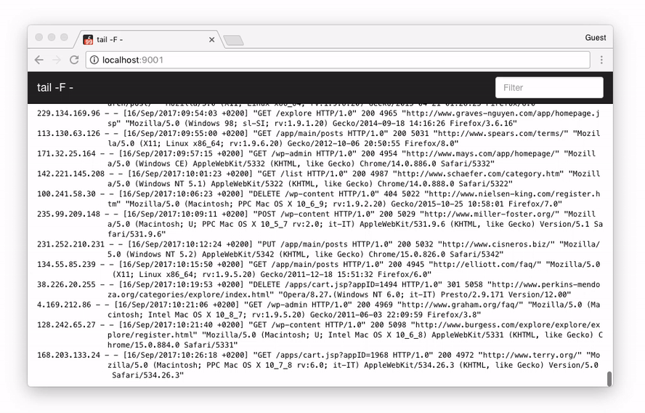
Real-time logfile monitors
First, locate your log files:
cd /var/log/httpd
or
cd /var/log/nginx

Slide 33
Real-time logfile monitors
Example 1:
tail -f access_log
Displays a real-time scrolling display of the access log, as it is being written.

Slide 34
Real-time logfile monitors
Example 2:
tail -f access_log SSL_access_log
Displays a real-time scrolling display of multiple files, as they are being written.

Slide 35
Real-time logfile monitors
Example 3:
tail -f access_log | grep -i Googlebot
Only show lines containing Googlebot (case-insensitive)
in the scrolling display.
Notes:
Works with multiple files. Use grep -v to exclude a term. Use grep -iv for case-insensitive excluding.

Slide 36
Where is that String?
"It's either in a file,
or it's in the database"
How to search both

Slide 37

grep
g/re/p - global search for regular expression and print
Case-sensitive search through one or
more text files for a string, and then show
all the lines that contain that string.

Slide 38
grep
Example 1:
Search the web server log for an IP address:
grep 51.255.71.120 access.log
51.255.71.120 - - [28/Dec/2017:03:43:04 -0800] "GET...
51.255.71.120 - - [28/Dec/2017:05:37:33 -0800] "GET...
51.255.71.120 - - [28/Dec/2017:06:15:00 -0800] "GET...
"If Harry Potter had grep, he wouldn't have needed two movies to find those horcruxes"

Slide 39
grep
Example 2:
Search all the logs (in the current directory) for an IP address:
grep 51.255.71.120 *.log
son1_access.log:51.255.71.120 - - [28/Dec/2017:03...
son2_access.log:51.255.71.120 - - [28/Dec/2017:05...
son0_access.log:51.255.71.120 - - [28/Dec/2017:06...

Slide 40
grep compressed files
zgrep and bzgrep
Example: Search all compressed logs in the current directory:
bzgrep 51.255.71.120 *.bz2 > /tmp/srch1.log
zgrep 51.255.71.120 *.gz > /tmp/srch2.log
son1.log-209.bz2:51.255.71.120 - - [18/Nov/2017:22:47:54 -0800] "GET /ja/bl...
vis2.log-119.bz2:51.255.71.120 - - [18/Nov/2017:23:58:22 -0800] "GET /it/pr...
vis2.log-219.bz2:51.255.71.120 - - [19/Nov/2017:03:03:55 -0800] "GET /kr/nb...

Slide 41

Recursive grep
Search for a string in any file at or beneath the current directory
cd sites/all/modules/custom
grep –rin some_unique_string
-r = Recursive search
-i = Case-insensitive
-n = Print line numbers
Tip: Make a shortcut alias with alias grin='grep -rin'

Slide 42
grep Your MySQL Database
No luck with recursive string searches?
Here's how to grep your database.
Download, read, and configure the dumpXMLtables.php script, https://github.com/nightbeacons/Expecto_Patronum
Run dumpXMLtables.php. It writes an XML file for each table in your database. (users.xml, watchdog.xml, . . .)

Slide 43
grep Your MySQL Database
3. grep -i for your target string.
(Tip: If you get a large search result, redirect the output to a file.)
The grep shows the table name (as the name of the XML file)
as well as the column name and the target string.

Slide 44
grep Your MySQL Database
Example:
grep drupal *.xml
actions.xml: <field name="callback">node_export_drupal…
advagg_files.xml: <field name="filename">misc/drupal.js…
locales_source.xml: <field name="source">drupal name for…
table name column name

Slide 45

dumpXMLtables and dircmp
Very useful for very broken sites
Run dumpXMLtables.php to create a "before" snapshot of the database.
Rename the dump directory to before_xml
Notes:
We will be making "before" and "after" database snapshots, and comparing the two. To help isolate the issue, minimize the time between the Before and After snapshots.

Slide 46

dumpXMLtables and dircmp
Very useful for very broken sites
2. In Drupal, change just one thing.
(Typically, this will be your "prime suspect" component.)

Slide 47

dumpXMLtables and dircmp
Very useful for very broken sites
3. Re-run dumpXMLtables.php to create an "after" snapshot.
Rename that dump directory after_xml

Slide 48

dumpXMLtables and dircmp
Very useful for very broken sites
Use dircmp before_xml after_xml to discover all
changes to the database.
(Tip: Or use dircmpdiff for quick copy/paste ability!)

Slide 49
Images
and the
Command Line

Slide 50

Manipulating Images
Using convert, from imagemagick.org
If you can do it with Photoshop (or gimp), you can usually do it faster with convert:
Convert between formats (JPG, PNG, GIF -- even SVG!)
Resize, rotate, and optimize images
Make sprites and animated GIFs -- even from MP4 files
Adjust colors, apply special effects, draw shapes, and become master time, space, and dimension

Slide 51
Manipulating Images
convert -- some basic examples
convert banner.jpg banner.png
convert -geometry 50% big.jpg small.gif
convert -quality 51% original.jpg faster.jpg
convert --help | more

Slide 52

Manipulating Images
convert -- Power Tools: Example 1 - Animated GIFs
convert -delay 20 -loop 0 cradle*.gif \ animated_cradle.gif
Notes:
Example #1: Create an animated dog GIF, with 20/100ths of a second delay between frames, looping forever. Use all of the cradle.* files in the current directory, in alpha order. The \ is a line-continuation

Slide 53

Manipulating Images
convert -- Power Tools: Example 2 - 50 Shades of Gray
convert -colorspace Gray fullcolor.jpg \ monochrome.png
Notes:
Create a monochrome PNG version of a full-color JPG
(Yes -- welcome to Seattle, where "50 Shades of Gray" is the weather report!")

Slide 54
Manipulating Images
convert -- Power Tools: Example 3 - From the Web
curl -s http://drupal.org/banner.jpg \ | - convert -resize 200% my.png
Notes:
Example #3: Fetch a banner from a web site, double its size and save it as a PNG
curl -s = silent

Slide 55
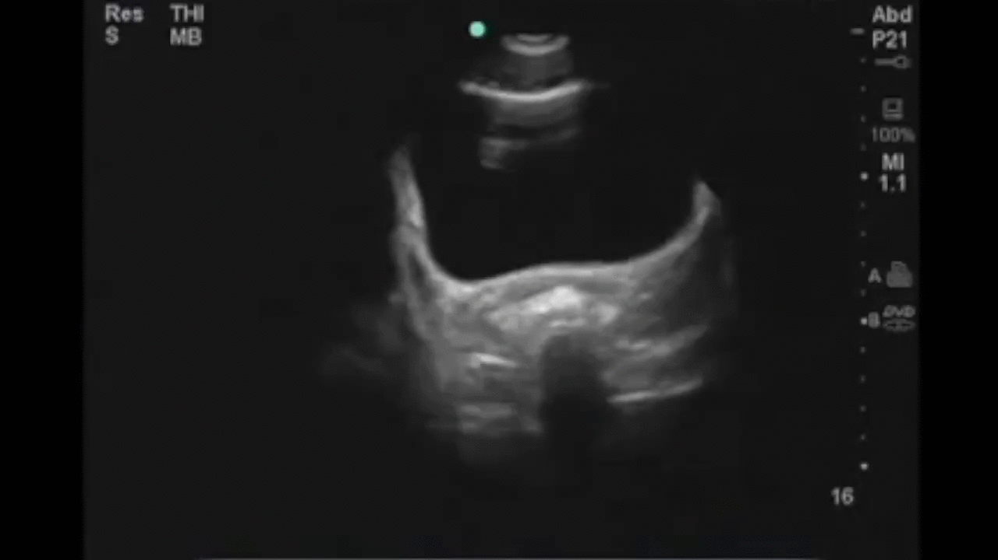
Manipulating Images
convert -- Power Tools: Example 4 - MP4 Conversion
convert -delay 20 video.mp4 -coalesce \ -layers optimize -loop 0 animation.gif
10042786 Apr 4 10:25 animation.gif
8797884 Apr 4 10:27 anim-gfscl.gif
975304 Apr 4 10:24 video.mp4
Notes:
The -delay 20 is the delay in "ticks" (1/100 of a second) 20 "ticks" is one-fifth of a second.
Disadvantage is file size. The resulting GIF is more than 10x the size of the source video. You can use tools like Gifsicle -- https://www.lcdf.org/gifsicle/ -- to optimize the image further, but even this only brings it down to nine times the size of the original MP4 Much more info at https://www.imagemagick.org/Usage/video/

Slide 56
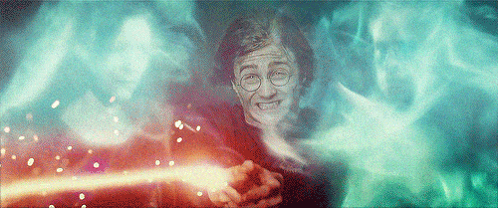
Advanced Spells

Slide 57

Sending Email
mail
Example 1:
echo "This is the body of the email" \ | mail -s "The Subject" ron@hogwarts.edu
Notes:
Very trivial example. By default, the sender of the mail will be <your_linux_username>@<your_linux_host>

Slide 58

Sending Email
mail
Example 2:
cat /tmp/msg.txt | \
mailx -s "One More" ron@hogwarts.edu
Notes:
Emailing the contents of a file.

Slide 59
Sending Email
mail
Example 3:
echo "Attachment attached" \ | mail -s "With Attachment" \ -a /var/www/image.png ron@hogwarts.edu
Notes:
Sending email with an attachment

Slide 60

scp
"secure copy"
Send a local file to a remote system:
scp myfile.txt harryp@hogwarts.edu:/var/www
Copy multiple files from a remote system to yours:
scp ron@hogwarts.edu:/tmp/images/*.jpg \ /var/www/images
Notes:
Permissions issues.
Wildcards OK for sending and receiving

Slide 61
scp
"secure copy" - recursive
Send an entire directory structure to a remote system:
scp -rp spamfolder \ draco@hogwarts.edu:/var/www
Notes:
Great of occasional "spur of the moment" use when you just want to copy a directory to another system. For more fine-tuned control, look at "rsync" -- it takes a bit longer to set up, but provides greater control.

Slide 62

Automating
(almost)
Anything
Using cron and the crontab command

Slide 63
Automating Anything
crontab -l List your cron table
Example:
crontab -l
# Generate the video sitemap
15 5 * * 0 /path/bin/Vsitemap.drush
45 2 * * * /home/ron/tMon.php >/dev/null 2>&1
Notes:
Use a "#" at the beginning of a line for comments
Older versions of cron do not like empty lines
Yes, you can use drush scripts, command-line PHP scripts, and shell scripts
By default, cron uses Bourne shell (not Bash) -- you may need to adjust your script
Errors emailed to the owner of the cron (that's you)
The /dev/null code in the bottom cron is a "silencer" -- any output will be suppressed. (Do not use until you are 100% sure that your script is bulletproof)

Slide 64
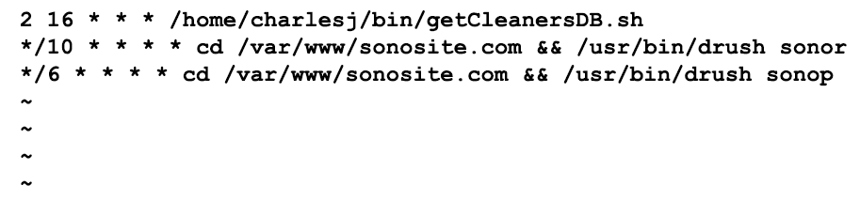
Automating Anything
crontab -e Edit your cron table
Loads your cron table into your default editor
(typically vi). Save the file to activate:
Notes:
To use a different editor, add the line
export EDITOR=vim (or whatever you like) into your .bashrc file.
*/10 is every 10 minutes, */6 is every 6 minutes

Slide 65
Automating Anything
The five cron scheduling fields:
Field Allowed Values (* = wildcard)
minute 0-59
hour 0-23
day of month 1-31
month 1-12
day of week 0-7 (0 or 7 is Sun)
(Tip: man –s5 crontab will show this info, and much more!)

Slide 66
Automating Anything
Security for cron:
Create the file /etc/cron.allow (if it does not already exist) and indicate the non-root users who should be allowed to use cron.
All other non-root users will be forbidden from using cron
Notes:
If either of the files /etc/cron.allow or /etc/cron.deny exist, only the users in those files will be allowed or denied. ('root' always has access)
cron is a popular target for hackers, and can be edited programmatically. (And many admins forget to check it.)

Slide 67

Defence Against
the Dark Arts

Slide 68

Defence Against the Dark Arts
Linux command-line tools provide fast and effective methods to isolate, identify, and analyze malicious activity on your site.
They can help you answer questions like How They Got In, How Long Have They Been Here, What Did They Do, and much more.

Slide 69
Defence Against the Dark Arts
How Did They Get In?
Check your web server access logs for suspicious POSTs
grep, zgrep, and bzgrep are your friends
Look for long strings of "garbage characters"
Keep lots of notes -- things can quickly get complicated
Don't ignore older logs

Slide 70
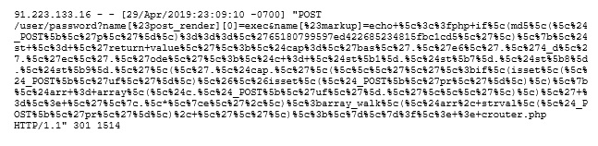
Defence Against the Dark Arts
zgrep POST hogwart-access.log*.gz > /tmp/file1.log
Checks each compressed logfile for the string POST, and writes the results to /tmp/file1.log.
Next, visually scan /tmp/file1.log for POSTs that look like this:
Make a note of the IP address, timestamp, and return code
Notes:
Easier to scan if you use a line-wrapping text editor. Each logfile entry is one logical line. You are looking for urlencoded strings -- they will be easy to spot.

Slide 71
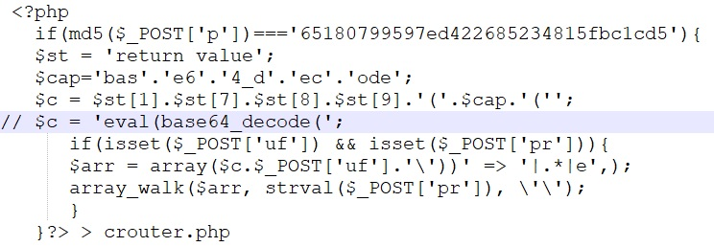
Defence Against the Dark Arts
Copy and paste that entire line into a URL decoding tool, such as urldecoder.org
Here is the url-decoded POST:
Notes:
The highlighted area is a comment that I added to explain the line above it. Hackers go to great lengths to obfuscate their code.
This code is attempting to write a file called crouter.php

Slide 72
Defence Against the Dark Arts
Next, use the find command to recursively scan your file system for the crouter.php file.
Example:
find /var/www/html -print | grep crouter.php
Notes:
This begins a search for the crouter.php file.
Don't be surprised if nothing shows up -- hackers are experts at hiding their tracks.
Often, the target file will be renamed and/or copied to multiple locations.

Slide 73
Defence Against the Dark Arts
Another method of searching the logs
zgrep POST hogwarts-access.log*.gz | grep -i "%3c%3fphp"
Search through a directory of compressed logs, searching for the string "%3c%3fphp" -- which is a URL-encoded version of "<php"
URL encodings are not case sensitive. Use grep -i for a case-insensitive search.

Slide 74
Defence Against the Dark Arts
Other useful strings to search for:
wget
curl
pastebin.com
repo-linux.com
base64_decode
eval
%2fbin%2fsh ( /bin/sh )
bin%2f/perl ( bin/perl )
Notes:
Many PHP scripts use base64_decode() to further obfuscate the code.

Slide 75
Defence Against the Dark Arts
What gifts did they leave behind?
From your notes, get the timestamp of the first suspicious POST, and then get a filesystem backup file that is a little bit older.
Extract that backup file into a parallel directory,
such as /var/www/html_OLD
Use our dircmp tool to compare your backup with the current directory.
This will quickly reveal any files that may have been added.

Slide 76
Defence Against the Dark Arts
What gifts did they leave behind?
Example:
cd /var/www
dircmp html html_old
only in html/sites/default/files: crouter.php
Note: Avoid using grep -v to filter-out files that would be expected to change (such as advagg)-- your target could be there!

Slide 77
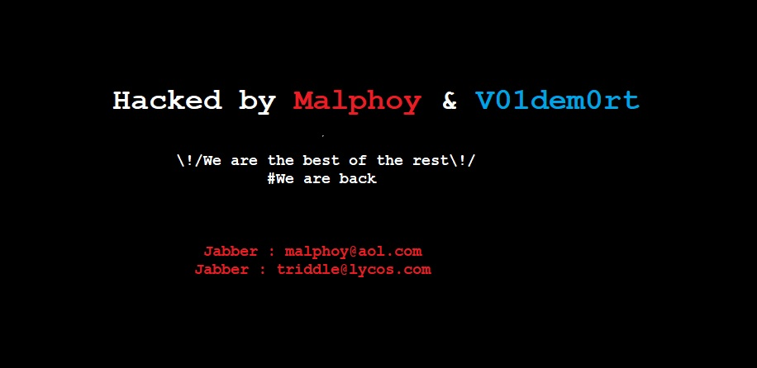
Defence Against the Dark Arts
No honor among Dementors or Thieves
After an intrusion, it is common to find a plain HTML Brag Page left on your server.
Hackers widely circulate links to their "Brag Pages" for fun, fame, and one other reason . . .

Slide 78

Defence Against the Dark Arts
No honor among Dementors or Thieves
The "Brag Page" often auto-downloads a copy of the virus (often SWF-based) to anyone unfortunate enough to view the page!
If you discover a file like this, thoroughly examine the HTML before even thinking about viewing it in your browser.
Notes:
find /var/www -print | grep "\.htm" will quickly find .htm and .html files.

Slide 79
Just For Fun

Slide 80
Just For Fun - figlet
Example:
figlet Drupal Rocks
____ _ ____ _
| _ \ _ __ _ _ _ __ __ _| | | _ \ ___ ___| | _____
| | | | '__| | | | '_ \ / _` | | | |_) / _ \ / __| |/ / __|
| |_| | | | |_| | |_) | (_| | | | _ < (_) | (__| <\__ \
|____/|_| \__,_| .__/ \__,_|_| |_| \_\___/ \___|_|\_\___/
|_|
Notes:
You've probably seen these before. This is the spell you need to make them.
Notice that quotes are optional for multiple words.

Slide 81
Just For Fun - figlet
Redirect to a file:
figlet Harry\'s Linux Box >> /etc/motd
(This one adds the figlet to the system login message)
Notes:
To notice: Escape the single quote.
We are appending the figlet to the system-wide "Message of the Day" (motd) file, which is a text file that is displayed after login.

Slide 82
Just For Fun - figlet
Different Fonts:
figlet -f slant Butterbeer!
____ __ __ __ __
/ __ )__ __/ /_/ /____ _____/ /_ ___ ___ _____/ /
/ __ / / / / __/ __/ _ \/ ___/ __ \/ _ \/ _ \/ ___/ /
/ /_/ / /_/ / /_/ /_/ __/ / / /_/ / __/ __/ / /_/
/_____/\__,_/\__/\__/\___/_/ /_.___/\___/\___/_/ (_)
showfigfonts
Shows all available figlet fonts, with samples
Notes:
If you type figlet (followed by ENTER) you are in figlet interactive mode. Figlet will create a banner of whatever you type.
To exit this mode, press [Ctrl]-D
By the way -- FIGlet derives from "Frank, Ian, and Glenn's Letters" -- the three friends who developed it. (See www.figlet.org)

Slide 83
Just For Fun - fortune
Example:
fortune
yo-yo, n.:
Something that is occasionally up
but normally down.
(see also Computer).
Notes:
You've probably seen these -- here is how to make them

Slide 84
Just For Fun - cowsay
Example 1:
cowsay I LOVE this presentation
__________________________
< I LOVE this presentation >
--------------------------
\ ^__^
\ (oo)\_______
(__)\ )\/\
||----w |
|| ||
Notes:
It's supposed to be a cow

Slide 85
Just For Fun - cowsay
Example 2 -- not always a cow:
cowsay –f ghostbusters Who ya gonna call?
____________________
< Who ya gonna call? >
--------------------
\
\
\ __---__
_- /--______
__--( / \ )XXXXXXXXXXX\v.
.-XXX( O O )XXXXXXXXXXXXXXX-
/XXX( U ) XXXXXXX\
/XXXXX( )--_ XXXXXXXXXXX\
/XXXXX/ ( O ) XXXXXX \XXXXX\
XXXXX/ / XXXXXX \__ \XXXXX
XXXXXX__/ XXXXXX \__---->
---___ XXX__/ XXXXXX \__ /
\- --__/ ___/\ XXXXXX / ___--/=
\-\ ___/ XXXXXX '--- XXXXXX
\-\/XXX\ XXXXXX /XXXXX
\XXXXXXXXX \ /XXXXX/
\XXXXXX > _/XXXXX/
\XXXXX--__/ __-- XXXX/
-XXXXXXXX--------------- XXXXXX-
\XXXXXXXXXXXXXXXXXXXXXXXXXX/
""VXXXXXXXXXXXXXXXXXXV""

Slide 86
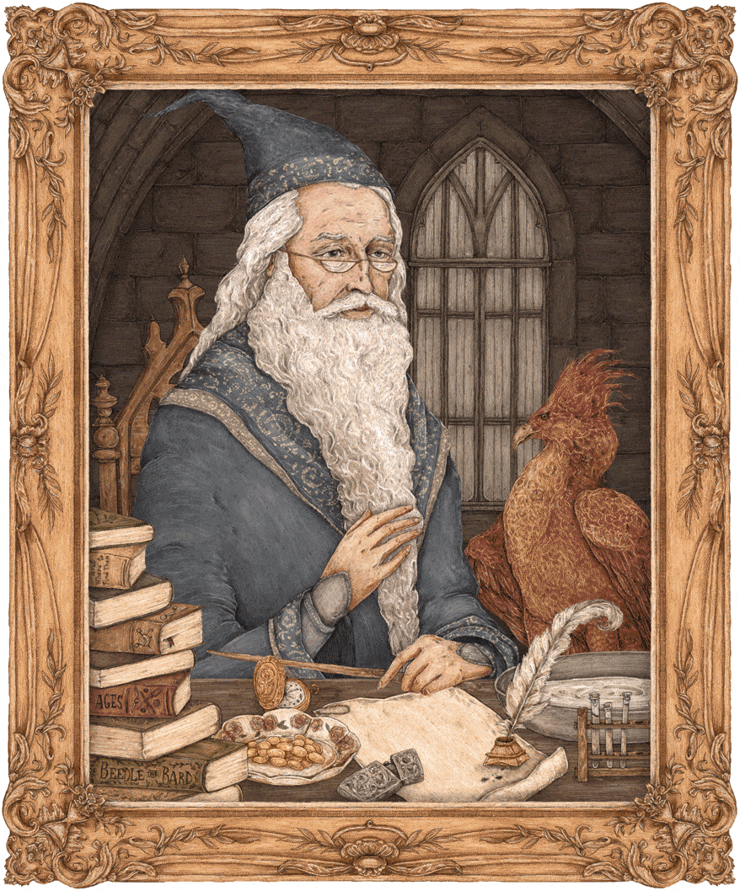
Just For Fun - cowsay
Example 3:
fortune | cowsay
_______________________________________
/ It takes a great deal of bravery to \
| stand up to our enemies, but just as |
| much to stand up to our friends. |
| |
\ -- A. Dumbledore /
---------------------------------------
\ ^__^
\ (oo)\_______
(__)\ )\/\
||----w |
|| ||
Notes:
Send a fortune to cowsay

Slide 87
Learning More

Slide 88

Learning More . . .
Get to know your friendly neighborhood IT team
--help and -h and -usage flags
apropos (a hidden gem!)
and don't forget Google and Bing

Slide 89

Thank You
Aimee Degnan -- Hook42
Brian Thompson -- Mindgrub
Damon Logan -- Fujifilm SonoSite
Kristen Pol -- Hook42
Rick Hawkins and the Seattle Drupal Users Group (SeaDUG)

Slide 90

Thank You
Happy and safe
Wizardry
Presentation slides, spells, charms, and other goodies may be manifested from:
https://github.com/nightbeacons/Expecto_Patronum

Slide 91
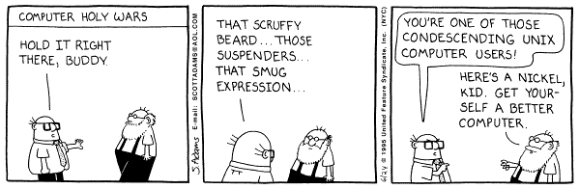
Prof. Charles Jackson
Charles.Jackson@fujifilm.com
Senior Web Manager
Fujifilm SonoSite
Assistant Headmaster
Kernighan House
Hogwarts School of Witchcraft,
Wizardry, and Linux

Slide 92
Join us for
contribution opportunities
Friday, April 12, 2019
Mentored
Contribution
First Time
Contributor Workshop
General
Contribution
9:00-18:00
Room: 602
9:00-12:00
Room: 606
9:00-18:00
Room: 6A
#DrupalContributions

Slide 93

What did you think?
http://seattle2019.drupal.org/schedule
Take the Survey!
https://www.surveymonkey.com/r/DrupalConSeattle

